Slide 1

SSL: SECURED SOCKET LAYER

Slide 2
BACKGROUND WHY AND HOW
HOW TO CHECK IN THE BROWSER.

Slide 3
MAIN CONCERNS
SSL is a Secure Sockets Layer and
SSL is the standard security technology for establishing an encrypted link between a web server and a browser.
This link ensures that all data passed between the web server and browsers remain private and integral

Slide 4



Authentication of server
– How does client know who they are dealing with?
Bob’s web site
Alice thinks she is at Bob’s site, but Darth is spoofing it
Information integrity
– How do we know third party has not altered data en
route?
Bob’s web site
Address information
Change so item shipped to Darth

Slide 5
OVERALL PROCESS AND FIRST TWO PHASES ELABORATED

Slide 6
CERTIFICATES
Web sites that deal in ecommerce must have certificates for authentication



Installed at server
Transmitted to client for authentication Validated using CA’s public key
Server machine
CA
Client machine
Request for secure session
Browser
Web Container (JSP, ASP)
Certificate signed by CA

Slide 7
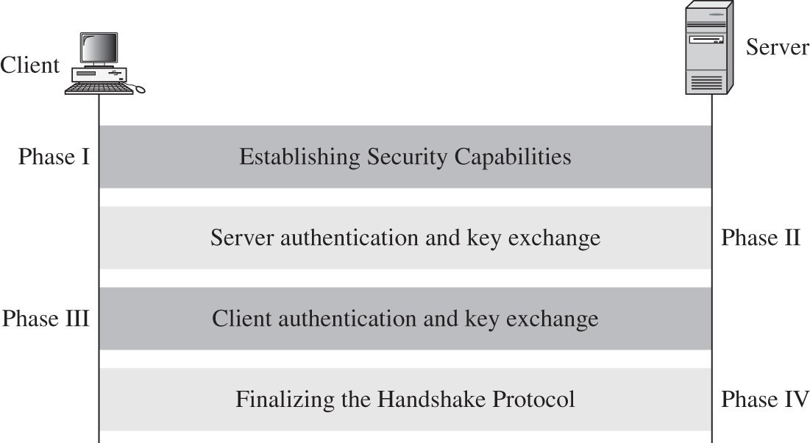
PROTOCOL
Secure Socket Layer protocol for web communication


Latest upgrade: Transport Layer Security (TLS) Same structure as SSL, somewhat more secure

Slide 8
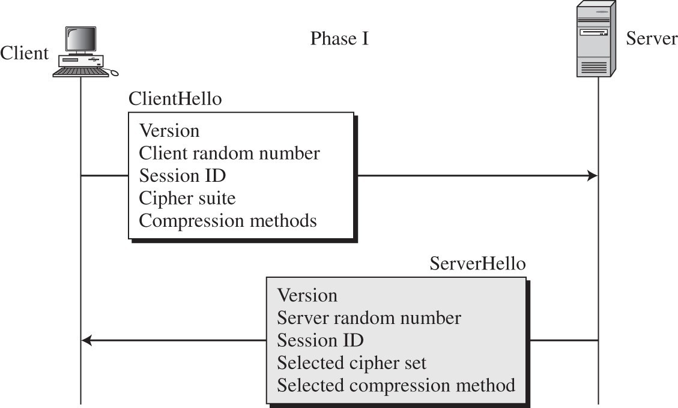
SSL PROTOCOL: PHASE 1
Phase 1: Information exchange
Problem: Large number of encryption algorithms in use


How do client and server agree on which to use? How does client tell server which ones it supports?

Slide 9
SSL PROTOCOL: PHASE 1
Client passes preferred algorithms to server via https request
Public key encryption algorithms
Private key encryption algorithms
Hash algorithms
Compression algorithms
Also random number for key generation
Server replies with algorithms that will be used
Also passes own random number

Slide 10
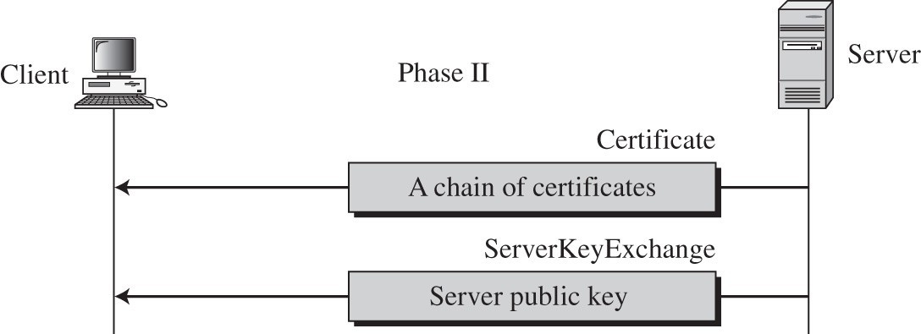
SSL PROTOCOL: PHASE 2
Phase 2: Server Identification and Key Exchange
Server passes their certificates to client



Client uses issuer public key to verify identity Client retrieves server public key from certificate
Server may pass many certificates for authentication

Slide 11
SSL PROTOCOL: PHASE 2
If no certificate containing a public key, separate public key must be passed
Certificate contains RSA public key, so no separate key passed
No certificate, so Diffie- Hellman key exchange parameters passed

Slide 12
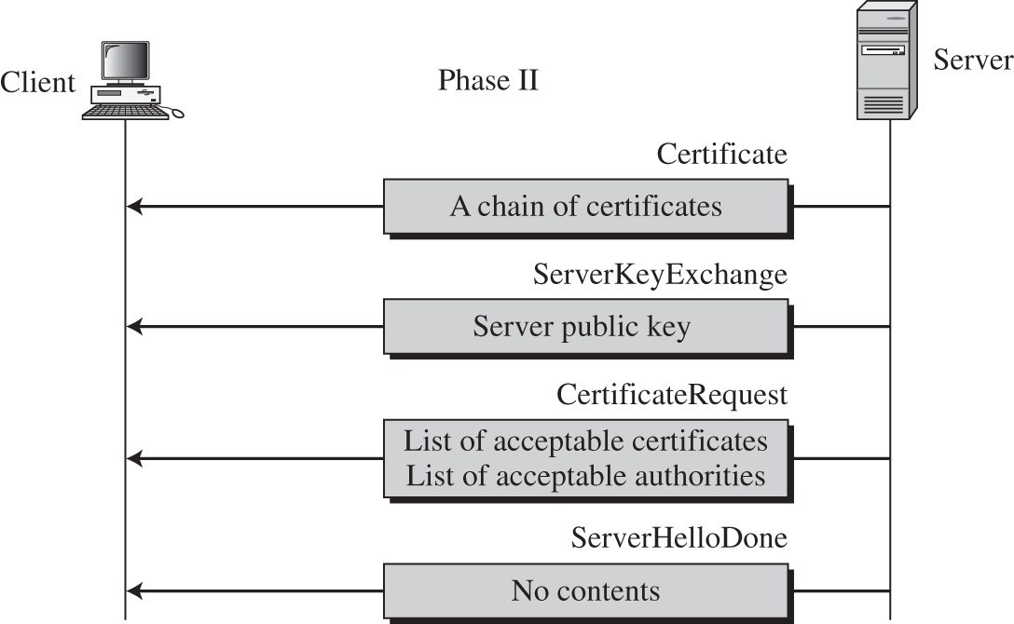
SSL PROTOCOL: PHASE 2
Server can also request appropriate client certificates to authenticate client
Online banking
Remote access to company database

Slide 13
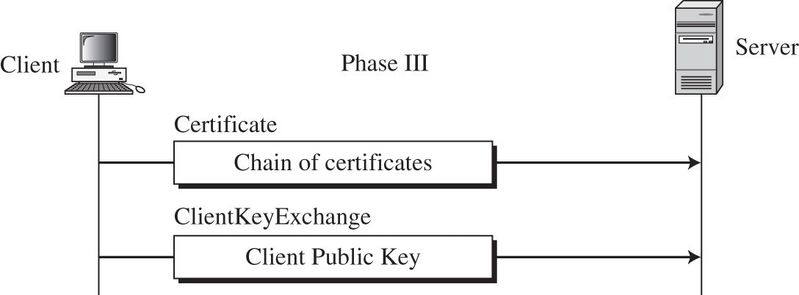
SSL PROTOCOL: PHASE 3
Phase 3: Client Identification and Key Exchange
Client sends certificate or public key if requested by server

Slide 14
ALGORITHM USED
○
DES. Data Encryption Standard, an encryption algorithm used by the U.S. Government.
DSA. Digital Signature Algorithm, part of the digital authentication standard used by the U.S. Government.
KEA. Key Exchange Algorithm, an algorithm used for key exchange by the
U.S. Government.
MD5. Message Digest algorithm developed by Rivest.
RC2 and RC4. Rivest encryption ciphers developed for RSA Data Security.
RSA. A public­key algorithm for both encryption and authentication. Developed by Rivest, Shamir, and Adleman.
RSA key exchange. A key­exchange algorithm for SSL based on the RSA algorithm.
SHA­1. Secure Hash Algorithm, a hash function used by the U.S. Government.
SKIPJACK. A classified symmetric­key algorithm implemented in FORTEZZA­compliant hardware used by the U.S. Government. (For more information, see FORTEZZA Cipher Suites.)
Triple­DES. DES applied three times.
○
○
○
○
○
○
○
○
○

Slide 15
CERTIFICATION AUTHORITY
50 root certificate authority worldwide
Needs to listed on browsers.
Undergo annual security audit (e.g. by Webtrust).
The large authorities are Verisign (acquired Thawte and Geotrust) has 48 %, GoDaddy 23%, and Combodo 15%, others 14%

Slide 16
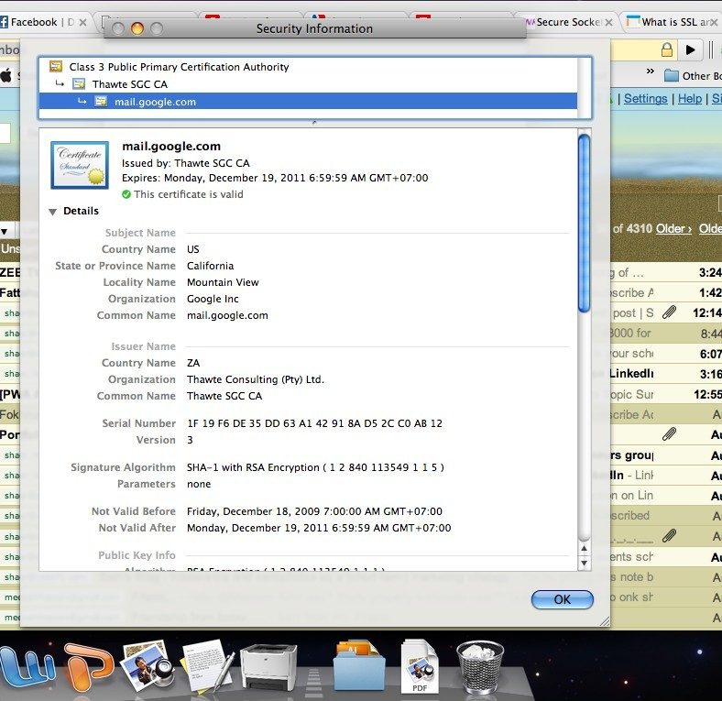

Slide 17
THANK YOU REFER TLS FROM TB

